Slide 1
Thinksboard Tutorial
Daniyal Haider

Slide 2
Table of Content
What is Thinksboard?
Understand working by:
Adding Device
Creating Dashboard
Adding widgets
Making alarms
Setting rules
Making customers and assigning

Slide 3
What is Thinks Board?
It is open source IOT platform that simplifies development and analysis of IOT applications.
It allows to connect devices, collect real-time, data visualization effectively and make discussions accordingly.

Slide 4
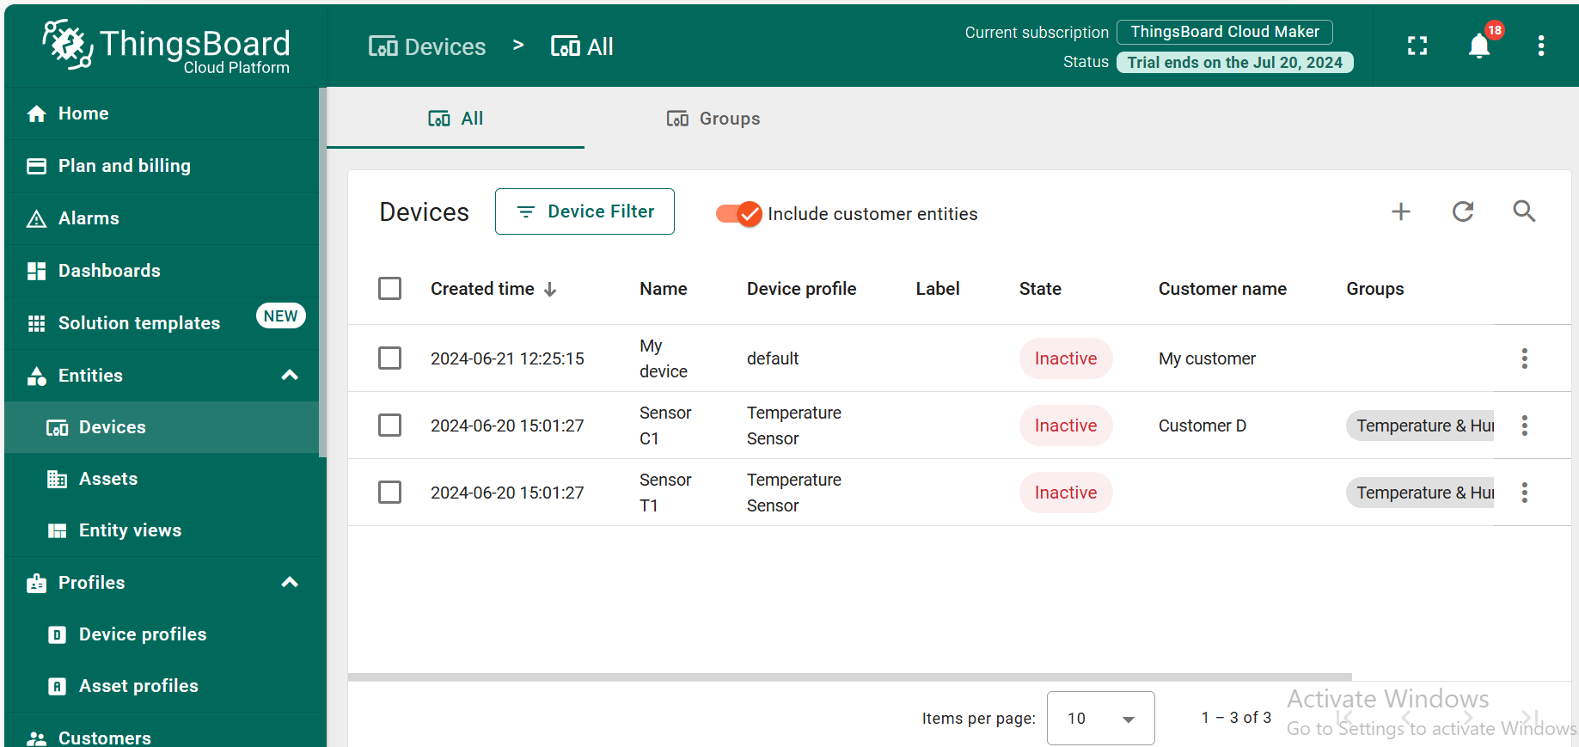
Step by Process to understand Working
Adding a device
To add a device we following process is to be followed:

Slide 5
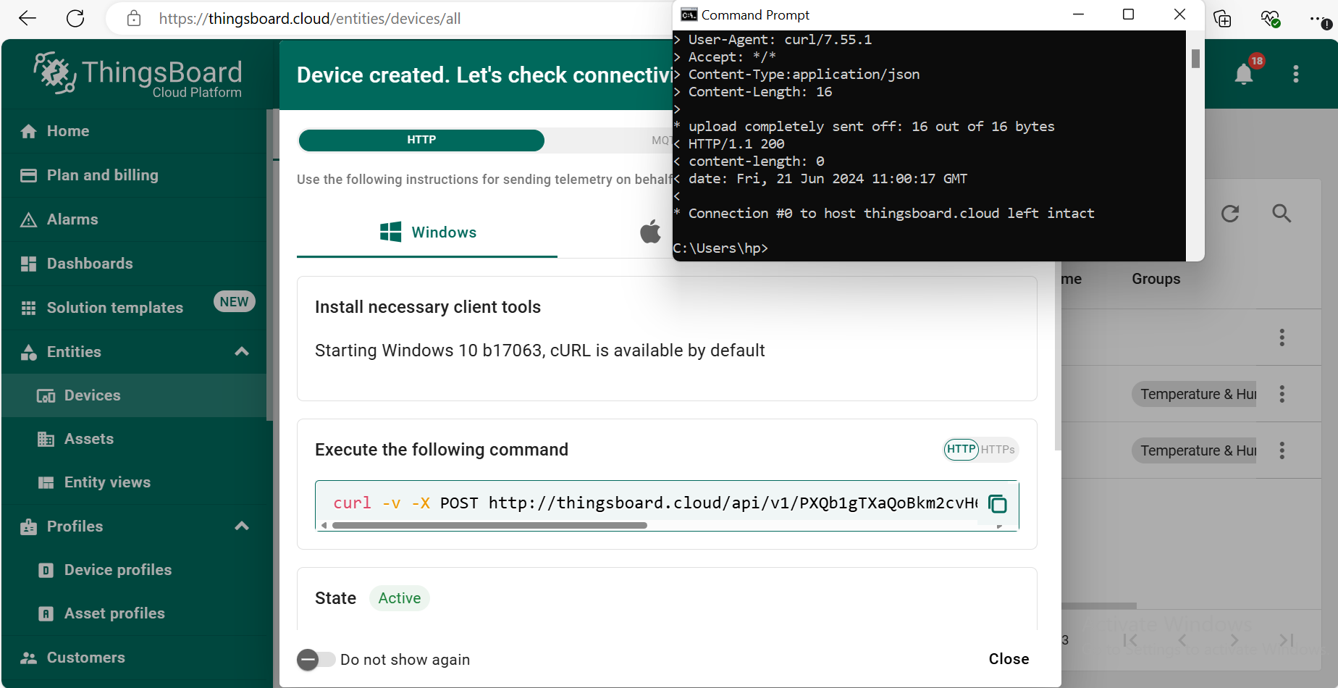
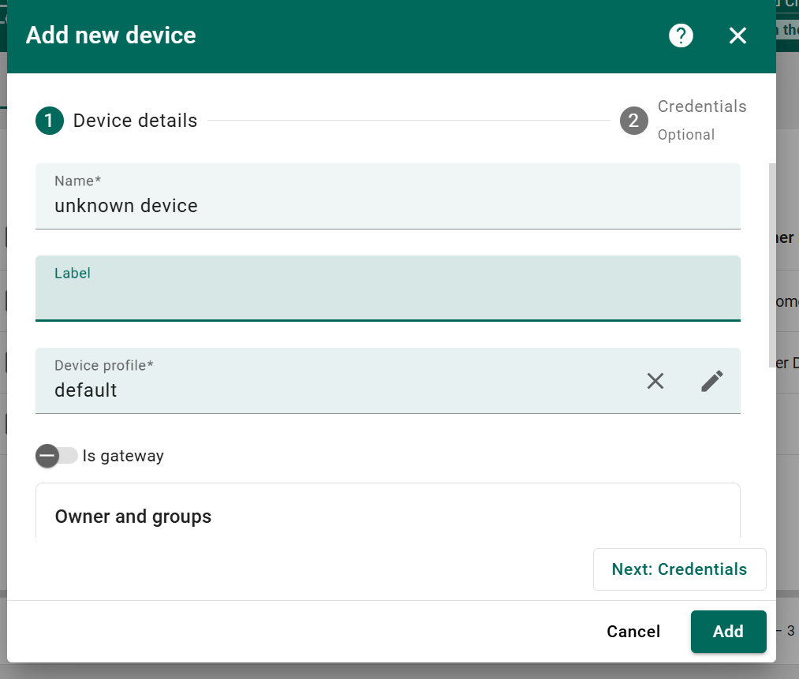
Add your device name and other info.
Activate your device by executing this link
Now your device is successfully added.

Slide 6
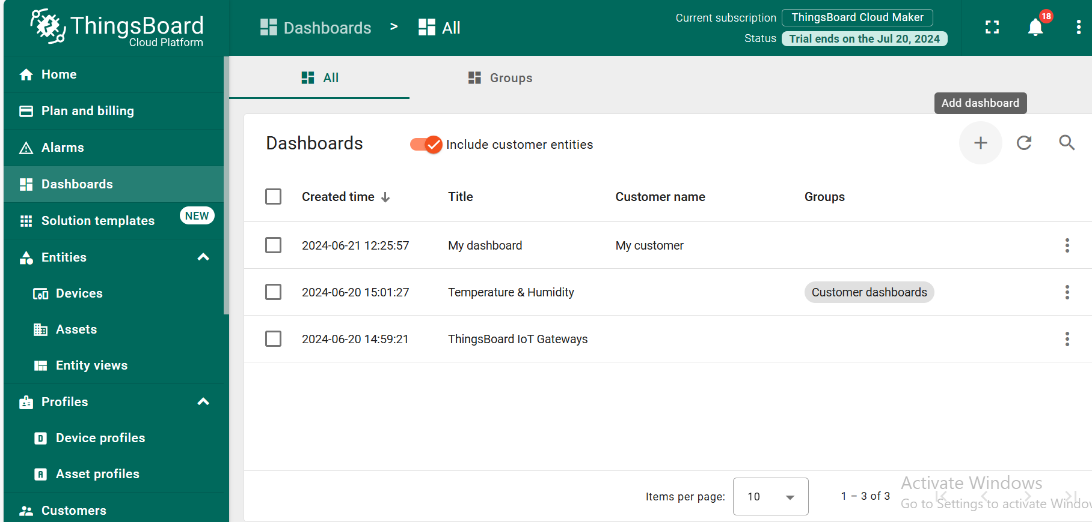
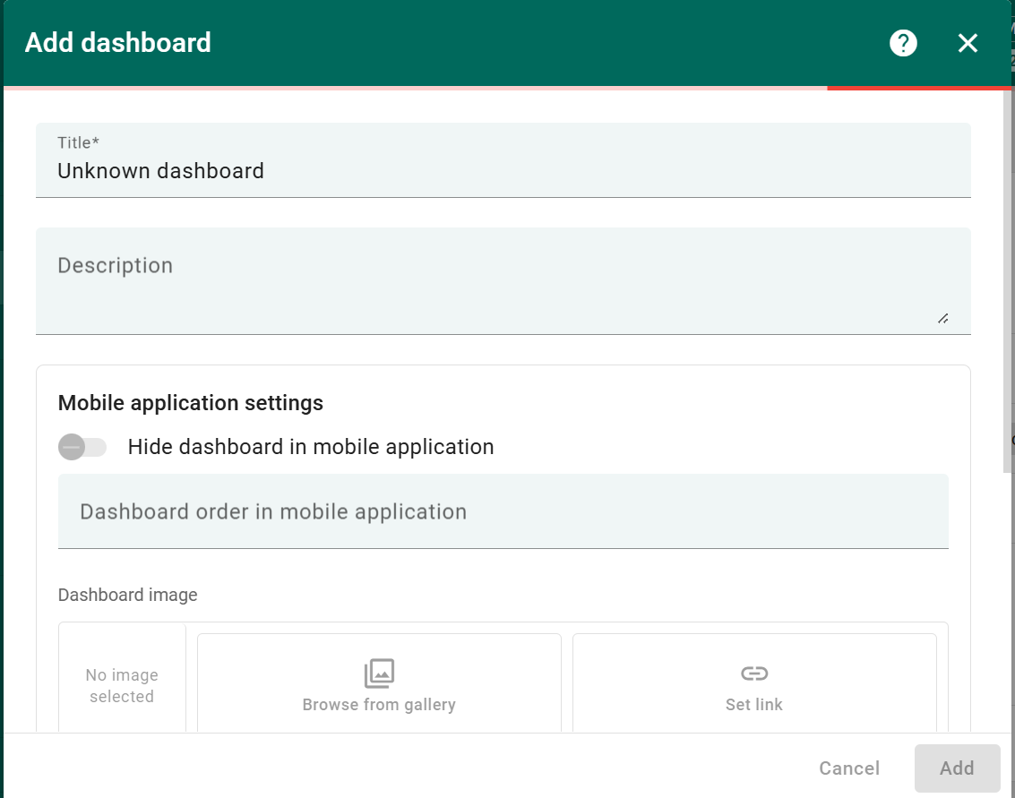
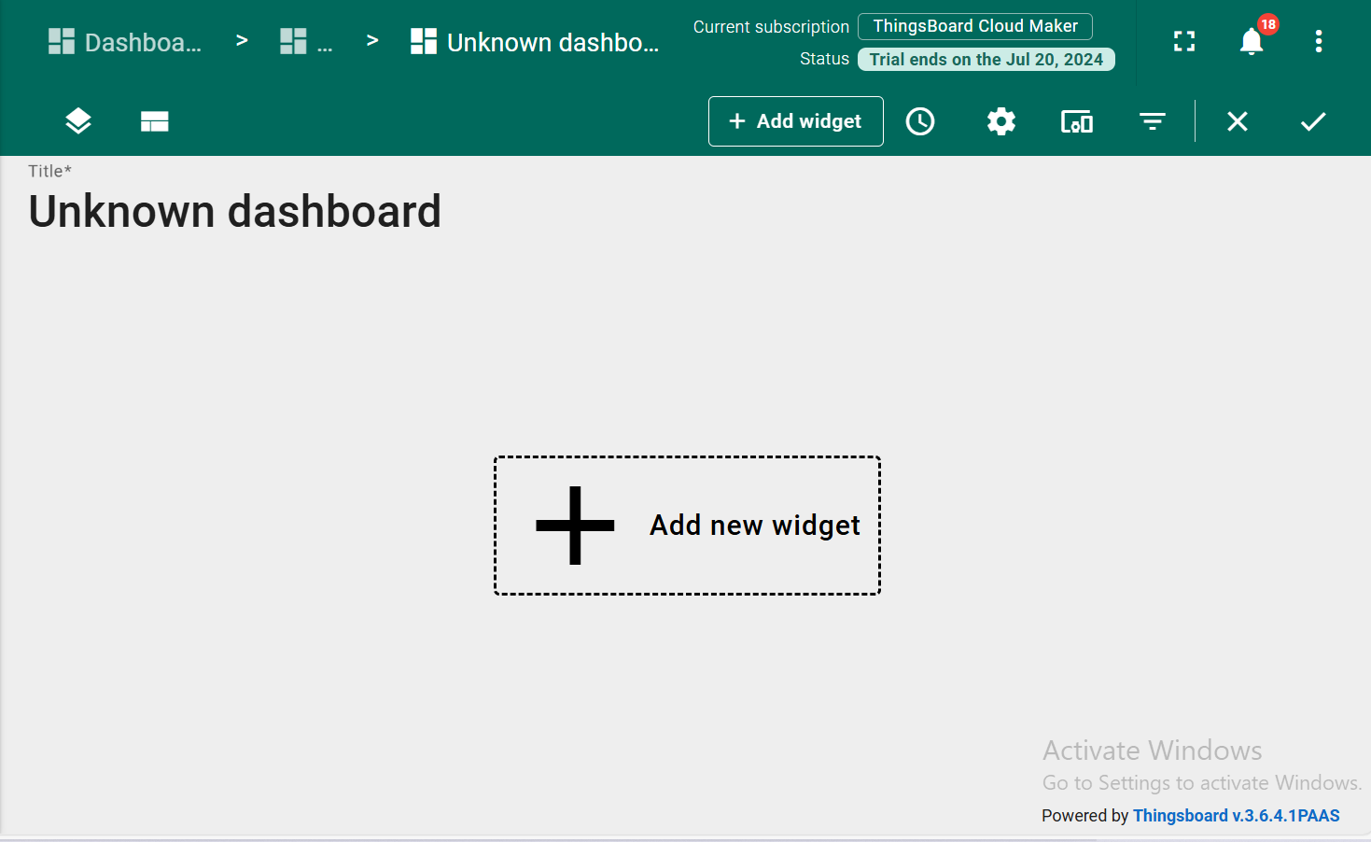
Now create a new Dashboard
Enter the dashboard info

Slide 7
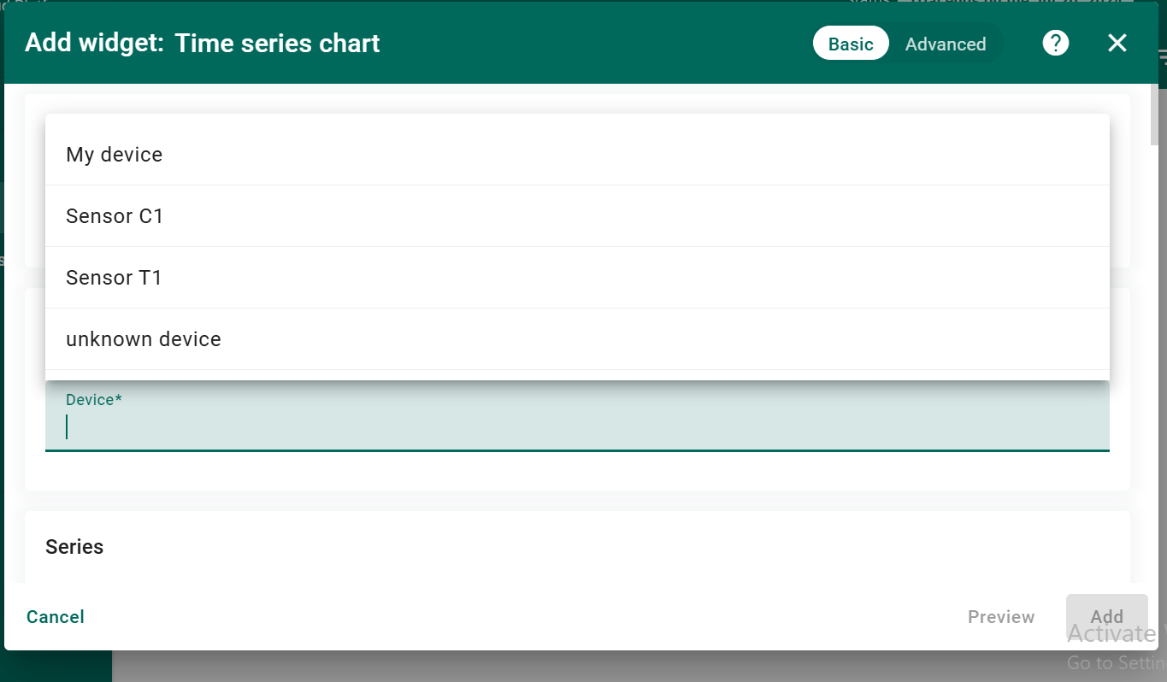
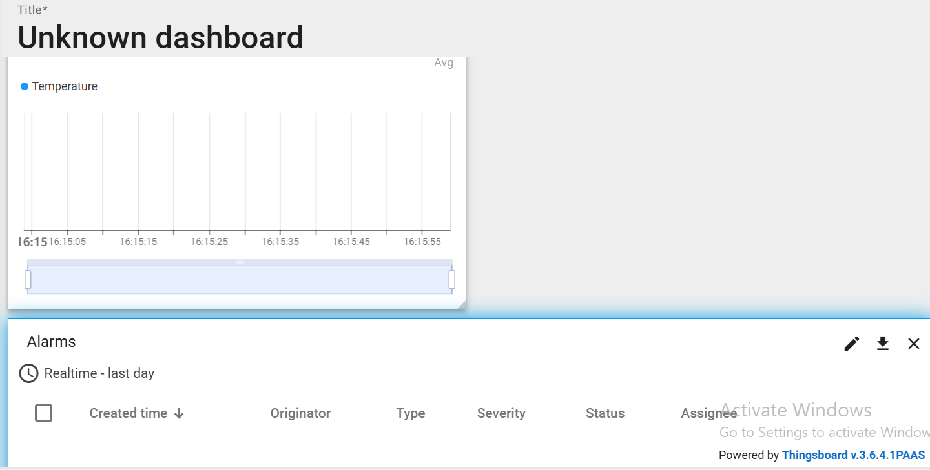
I added two widgets one of time series char and second for alarms

Slide 8
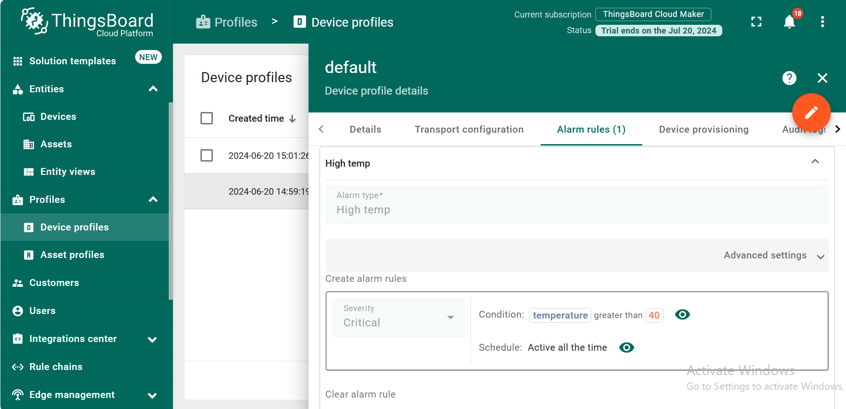
Now add alarms Rules

Slide 9
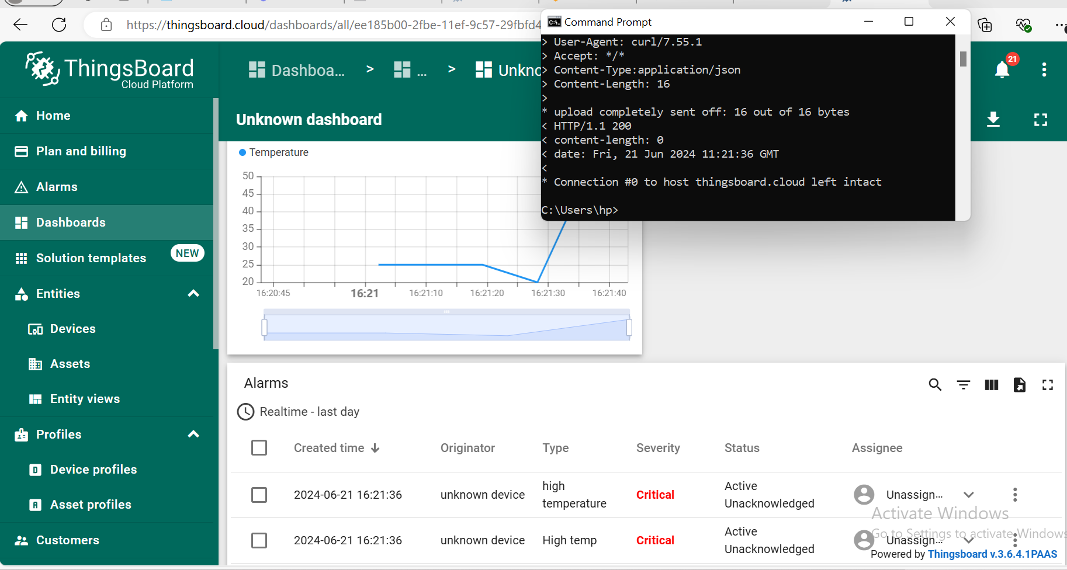
After setting rules whenever the condition will be satisfied the alarm will be generate and visualized accordingly on the dashboard.

Slide 10
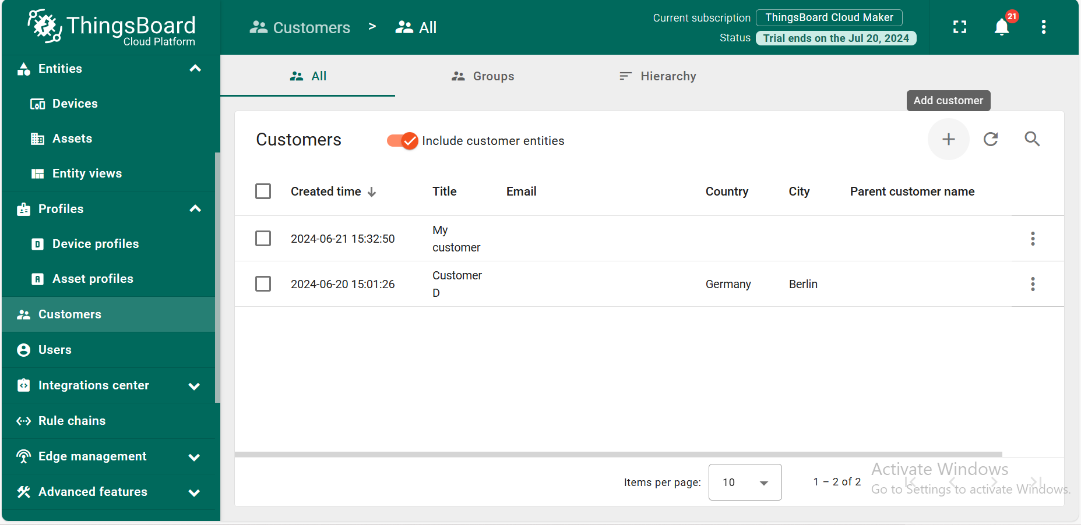
Adding customers
We can add customers and assign them dashboards and devices accordingly.
After assigning we will create accounts and assign them links to get notifications from the thinks board and they will have their own portal access.

Slide 11
